Slide 1
CMSC201
Computer Science I for Majors
Lecture 0X - Careers

Slide 2
Today’s Objectives
To introduce careers in Computer Science
To explore using Computer Science with
other fields (interdisciplinary)
Talk a little bit about grad school

Slide 3
Careers in STEM Fields

Slide 4
What is STEM?
STEM is an acronym referring to the academic disciplines of:
  Science,
  Technology,
  Engineering, and
  Mathematics

Slide 5
STEM Job Market (2013)
5.7 million total postings in STEM fields
4.4 million (76%) require at least a
bachelor’s degree
2.3 million (41%) are entry-level jobs
  Requiring less than 2 years of experience
http://burning-glass.com/research/stem/

Slide 6
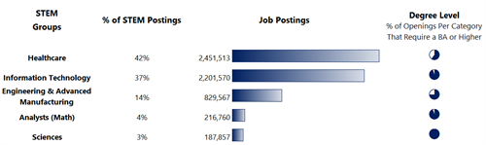
STEM Jobs by Career Area
http://burning-glass.com/research/stem/

Slide 7
Demand for STEM Graduates
48% of all entry-level jobs requiring a bachelor’s degree or higher are in STEM fields
  Only 29% of bachelor’s degrees are in a STEM field
There are 2.5 entry-level job postings for each new 4-year graduate in STEM fields
  Compared to 1.1 postings for each new graduate in non-STEM fields
http://burning-glass.com/research/stem/

Slide 8
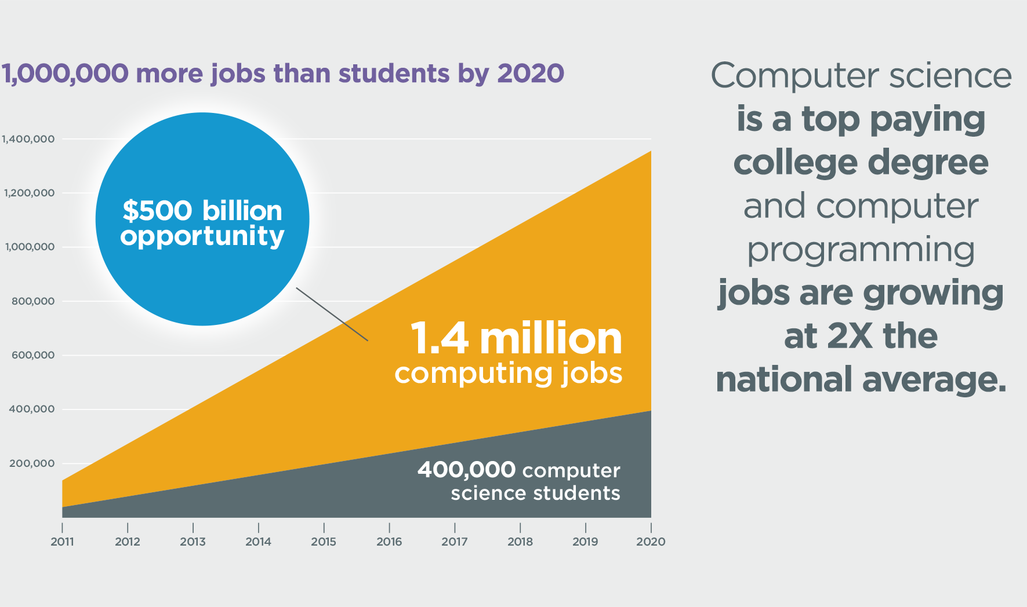
Demand is Only Growing
http://newsroom.unl.edu/announce/cse/3727/20691

Slide 9
Interdisciplinary Computer Science

Slide 10
Learning to Program is for Everyone
In the Lost Interview with Steve Jobs, he said:
  “I think everybody in this country should learn how to program a computer because it teaches you
  how to think.”

Slide 11
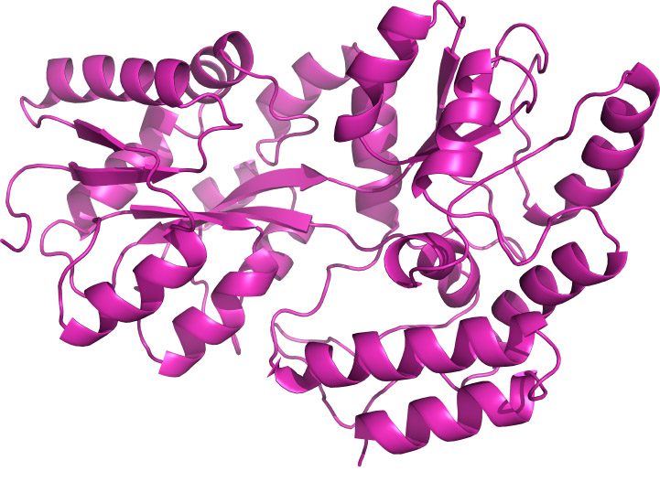

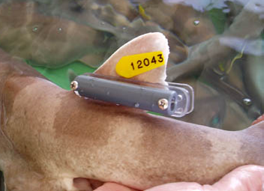
Computer Science and Biology
Human Genome Project
Tagging and tracking animals
Protein folding

Slide 12



Computer Science and Film
Animated films
Motion capture
CG special effects

Slide 13

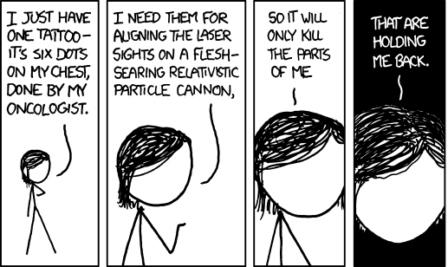

Computer Science and Healthcare
Pharmaceutical manufacturing
Predictive diagnostics
Chemotherapy machines

Slide 14
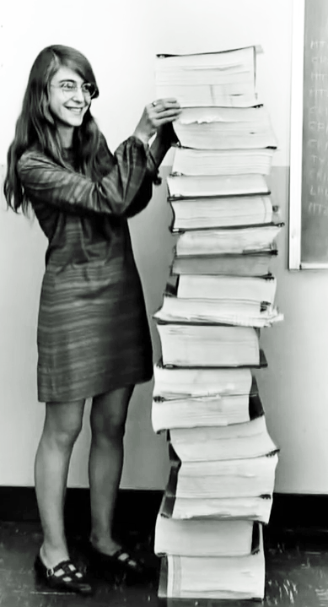
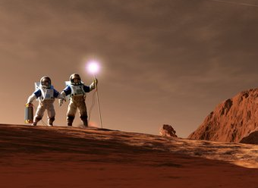
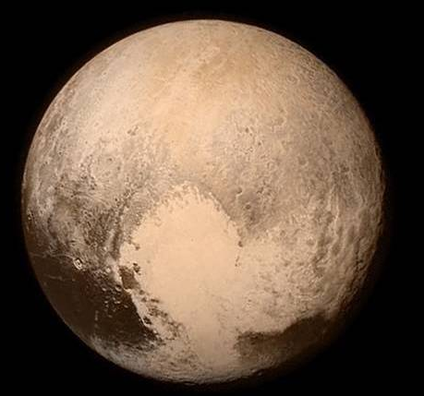
Computer Science and Space
Analyzing data from spacecraft
Planning the Mars mission
Programming landers, shuttles, etc.
Margaret Hamilton &
her Apollo 11 code

Slide 15

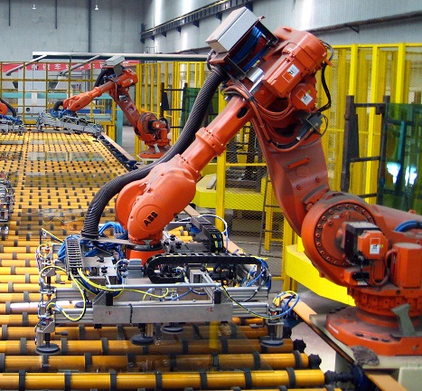

Computer Science and MechE
Google’s self-driving car
Automated factories
Robots!

Slide 16


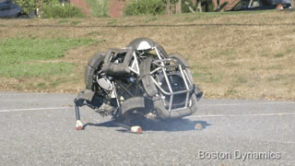
(More Robots)
Robot bloopers:
  https://www.youtube.com/watch?v=g0TaYhjpOfo

Slide 17
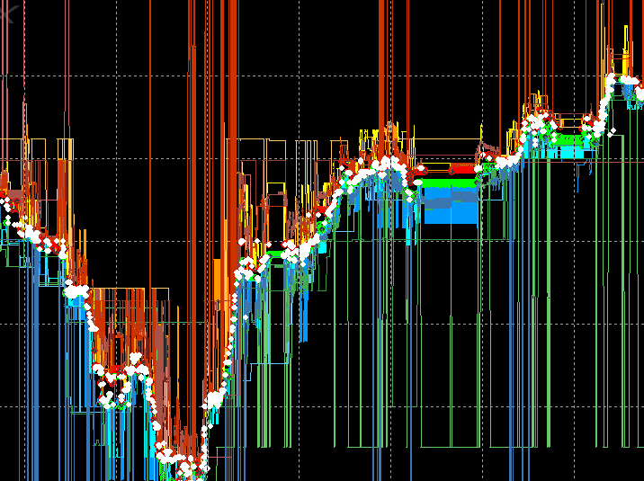
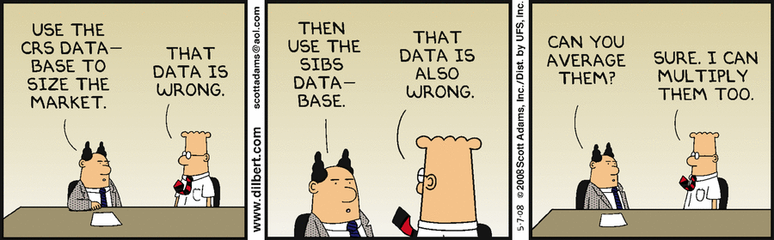

Computer Science and Finance
High-frequency trading
Computational finance
Risk analysis

Slide 18
Grad School

Slide 19
Why (or Why Not) Grad School?
Reflect – think about your education so far
  What are your passions?
  What are your goals in life?
  What excites you?
  What lifestyles might you want?
Avoid listening to what others tell you to do; think about what you want
http://web.cs.dartmouth.edu/undergraduate/major-redesign/advice-for-majors

Slide 20
Why (or Why Not) Grad School?
An MS is basically a technical degree that gives you more interesting job opportunities
A PhD is basically a research degree, which opens up a host of advanced and research-oriented opportunities
In industry, MS and PhDs are often a ticket to eventual upper-level management
http://web.cs.dartmouth.edu/undergraduate/major-redesign/advice-for-majors

Slide 21
How Long is Grad School?
MS
  1 to 2 years is typical
PhD
  4 to 6 years is typical
  It can take longer! (8 years or more)
    Many schools have a limit to how long you can take
http://web.cs.dartmouth.edu/undergraduate/major-redesign/advice-for-majors

Slide 22
What Is It Good For?
MS is essentially a technical degree
  Open up a range of much more interesting jobs
  More responsibility, creativity, flexibility, and income
PhD is basically a research degree
  Research today is collaborative (interdisciplinary!)
  No “lonely hacker toiling away alone in the night”
  Many become professors and also teach classes
http://web.cs.dartmouth.edu/undergraduate/major-redesign/advice-for-majors

Slide 23
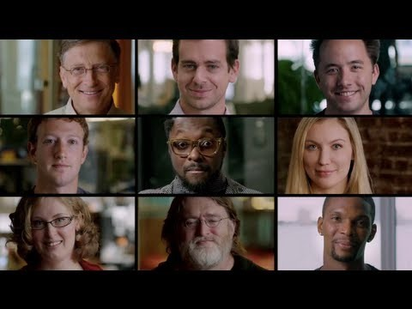
What Most Schools Don’t Teach
https://www.youtube.com/watch?v=nKIu9yen5nc

Slide 24
Announcements
Labs will meet in person starting next week
Lab 1 is due by Thursday night
Homework 0 is out now
  Not “worth” points, but important material
Next Class: Variables

